Slide 1
ClinsightAI : Transforming Unstructured Patient Feedback into Decision Intelligence.
Hi everyone, we are the team behind ClinsightAI Problem. Multi-location healthcare groups are drowning in unstructured patient reviews. They know patients are complaining, but they struggle to quantify the financial impact of those complaints or distinguish between a one-off bad day and a systemic operational failure. We built a platform to solve exactly that

Slide 2
The Problem with Current Analytics
Staff was incredibly friendly and I was seen within 15 minutes of arriving. – positive
Excellent care and attention to detail.- positive
They charged my copay and then referred me elsewhere. – negative
etc

Slide 3
The Problem with Current Solution
Current solutions rely on basic sentiment analysis telling a clinic they have 'negative' reviews. But 'negative' doesn't give a hospital administrator an action plan. Furthermore, trying to manually read and categorize thousands of reviews is impossible. We needed an AI system that didn't just read text, but extracted a quantified, prioritized business roadmap.

Slide 4
Model where the numerical features were generated by LLM
Raw Data -> LLM generates math -> Hallucinated Stats
--------------------------------------------------------------------------------------------------------------------------------------------
Model based on statistical/ Data science based approach to generate the numerical
Raw Data -> Gemini 2.5 Flash (Semantic Extraction) -> Python/Pandas (Deterministic Math)-> Factual Dashboards

Slide 5
When we started, we took the standard hackathon approach: we fed all the reviews into a LLM and asked it to calculate the frequency and severity of operational issues. We immediately hit a wall. LLMs are predictive text engines, not calculators; they hallucinated the statistics. To make this enterprise-ready, we engineered a hybrid pipeline. We use Gemini strictly to extract semantic themes and keyword boundaries, and then pass those parameters into a deterministic Python engine. Our system dynamically feature-engineers the dataset in real-time. The insights on our dashboard aren't LLM guesses they are rigorous, mathematically true statistics.
This also cut the cost for the company that would have otherwise incurred for the each LLM call.

Slide 6
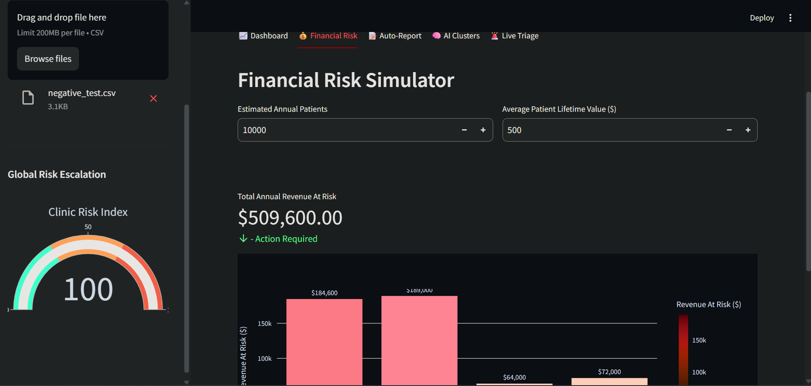
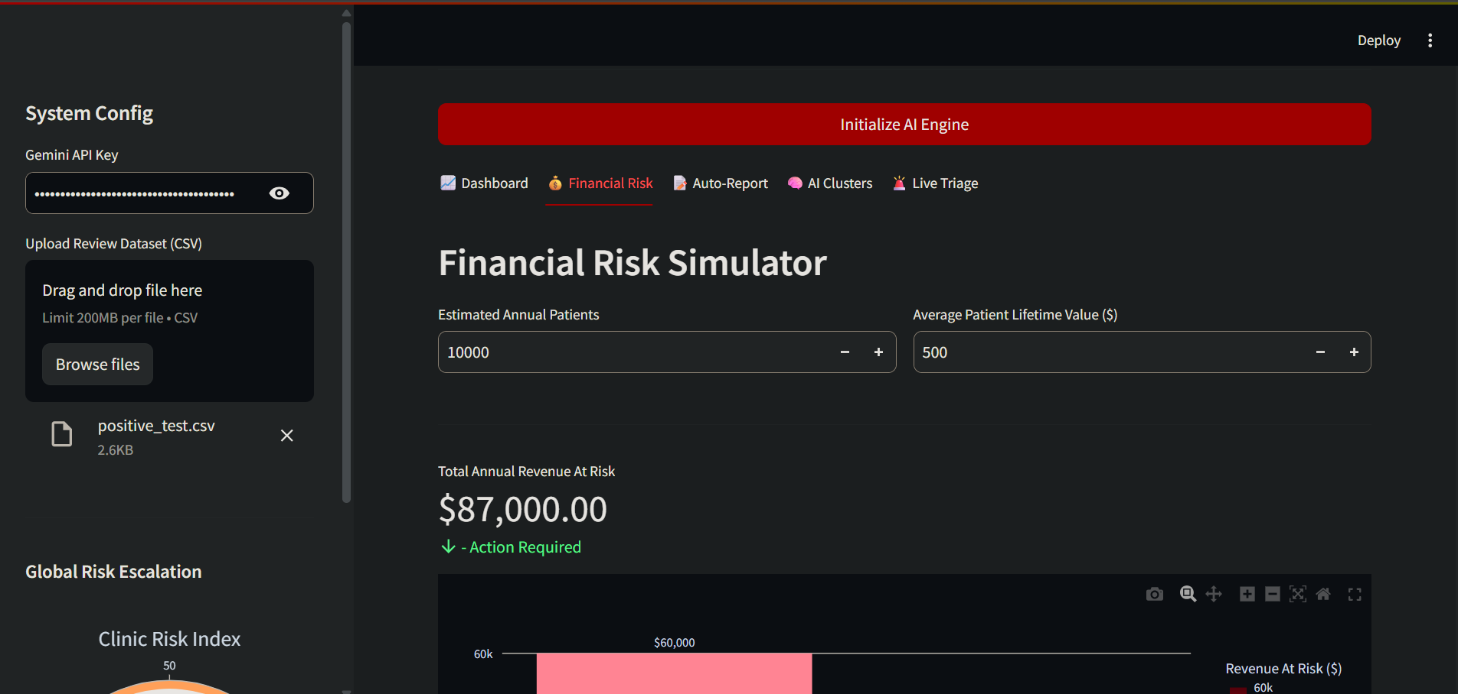
The Architecture & Overcoming AI Hallucinations
Model with hallucinations
Model based on statistical analysis
Raw Data -> Gemini 2.5 Flash (Semantic Extraction)
-> Python/Pandas (Deterministic Math)
-> Factual Dashboards
Raw Data -> LLM generates math -> Hallucinated Stats

